Slide 1
Your AI Team with
Claude Cowork
From Know-how to How-to
Notes:
Welcome I am a non-technical product manager, I am very interested in technology and innovation and have always been at the intersection of business and technology. But besides my professional life I also have the identity of being a hockey dad

Slide 2
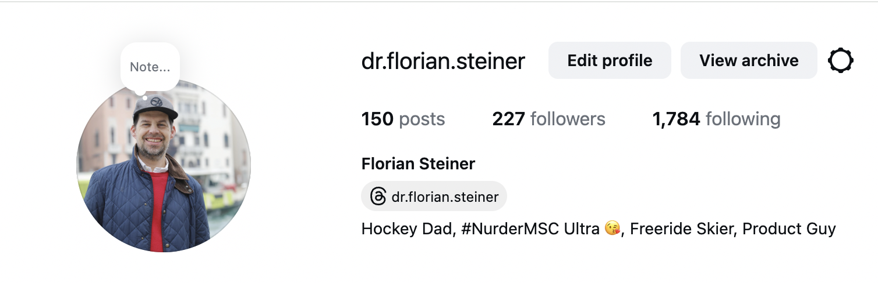
Honestly, my main identity is being a hockey dad
Notes:
My daughter plays field hockey since she was four. It all began with the film hanny and nanni and then we had to drive to the hockey club and to tournaments and hockey camps. It’s becoming a serious job. Who has also children with a hobby and knows this situation?

Slide 3
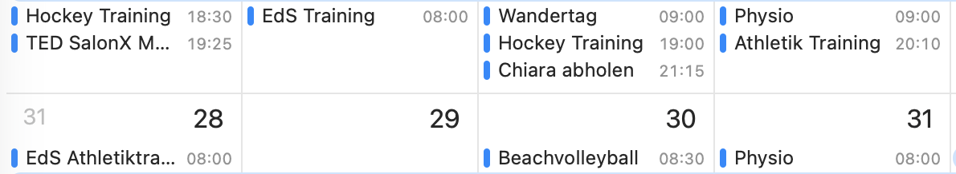
Being a hockey dad means you are the chief of staff
If it is not in my calendar, it doesn't exist.
Notes:
Being a hockey dad means being the orhganisator and coordinator for bringing children, collecting children, cheering at the pitch, traveling to tournaments, booking train tickets, hotel rooms, you get the idea. I am managing myself with my calendar. What is not in my calendar doesn not exist and I will probably miss it and not show up.

Slide 4
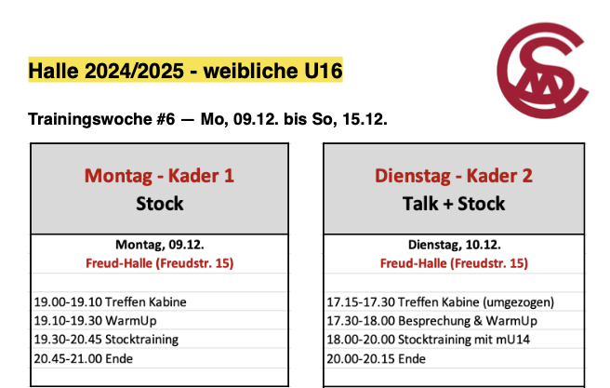
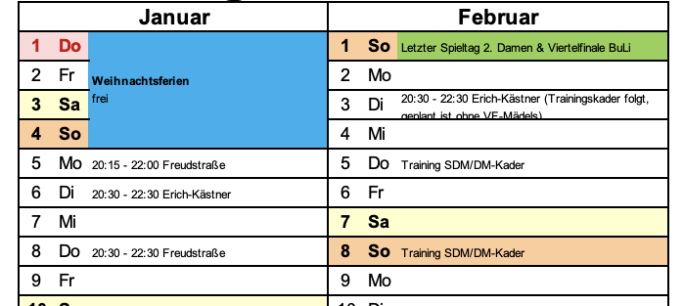
The coach is sending the schedule as PDF
I spend hours creating entries in the shared family calendar
Notes:
The challenge is that hockey coaches, the staff of the team and other parents send you schedules and dates in PDFs, Excel or Messages. I needed to copy and paste the information by hand into the calendar.

Slide 5
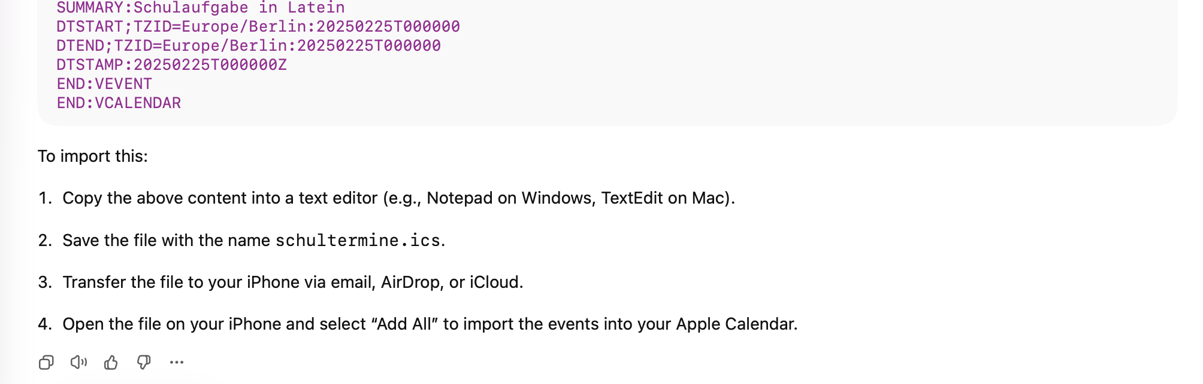
My first attempt was to solve it with a AI chatbot
The AI gave me the solution, but I still failed, because the text editor saved it as rich text format.
Notes:
So then chat gpt came along, I tried to figure out if i could generate ical files to make my life easier. It turned out being more difficult that I thought. ChatGPT could give me instructions, but I had to create the files and my editor safed it as RTF and not text and so it did not work.

Slide 6
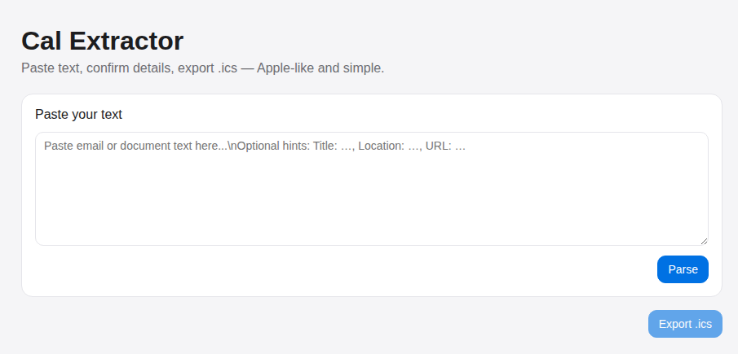
then I tried to create a web app
I have never used it, because it was too cumbersome to get it working.
Notes:
So the next approach was to build a tool that could translate any text form a mail, whatsapp message or a pdf into ical files. I spend some time with it and I could not get it to work as intended and I left it and created the calendar entries still manually.

Slide 7
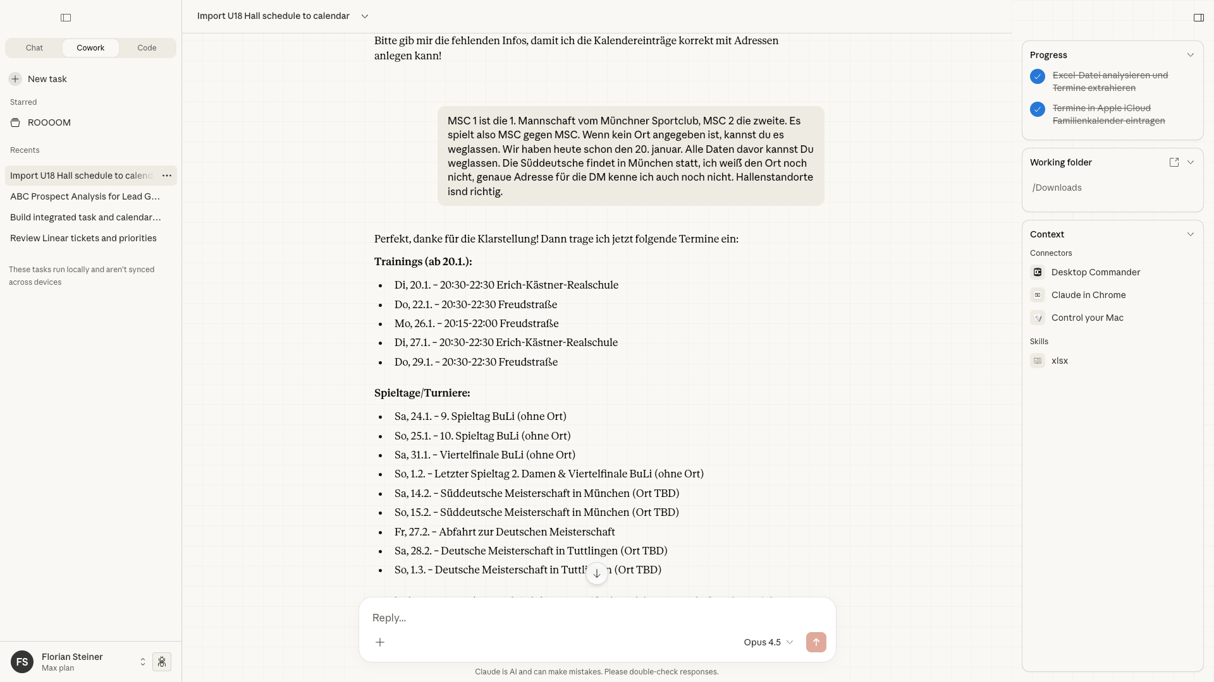
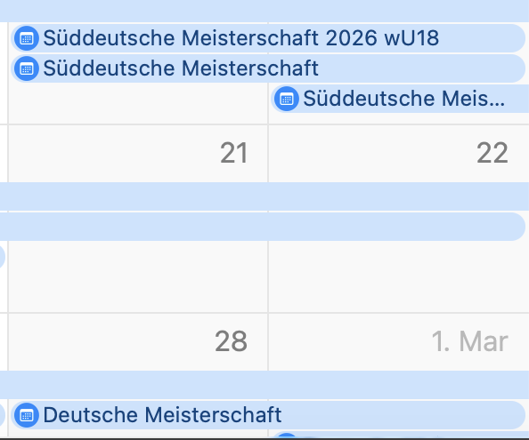
Claude Coworker finally solved the problem
Claude Coworker executes tasks and uses the browser and other apps to achieve the wished result.
It’s claude code for the rest of us!
Notes:
A week ago, Anthropic virtually released claude code for the rest of us, itÄs claude code in the desktop app, it has access to files, it can create plans, it executes on the plans and it can work on several tasks at the same time. I tried it for the last week for many things, bit I also gave it the schedule of the hockey trainings and tournaments and it read the information from the excel correctly, it asked good question about dates that were at the same time and ambiguous locations. After clarifying the questions it created all calender entries in my ical calendar, started the calendar and showed me the result.

Slide 8
Claude Code / Cowork bridges the knowing / doing gap
Knowing
Answer questions
Provide instructions
Do research on the web
Doing
Access to files
Skills
Execution of applications
Notes:
So what has changed. We had chatbots with all the knowledge on the internet, but tehy could not act, with cklaude code and claude coworker, we have agents that actually can work for us autonomiouslky for longer periods and do things and create deliverables.

Slide 9
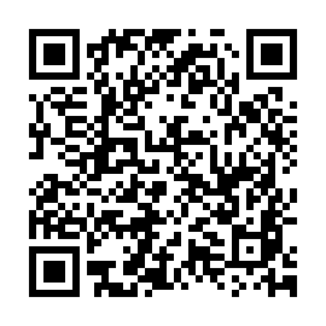
Connect on LinkedIN
Thank you for you attention!
www.linkedin.com/in/floriansteiner
Notes:
Thank you very much for you attention. If you need support for your work or projects please do not hesitate to contact me.

